Slide 1



Dr. Mitesh Hanwate
MBA, NET, SET, Ph.D., PGDHRM
HOD-IIMS
Sahayog Educational Campus

Slide 2
INTRODUCTION
Staffing is related to performing a set of activities which aim at inviting, selecting, placing and retaining individuals at various jobs to achieve the organizational goals.
Staffing deals with appointing people and placing them at the appropriate jobs.
Definitions:
“Staffing is the process of providing jobs to deserving people, through the function of recruitment, selection and training with-a-view to getting benefits from them, for the achievement of pre-set goals of organization. According to A. K. Singh,
According to Theo Heimann, “Staffing is concerned with the placement, growth and development of all those members of the organization whose function is to get the things done through the efforts of other individuals.”

Slide 3
NATURE OF STAFFING
Management function
People Cantered
Pervasive function
Part of human resource management
Deals with active resource
Continuous function

Slide 4
IMPORTANCE OF STAFFING
1. Emphasis on human element
2. Facilitates leadership
3. Facilitates control
4. Motivation to work
5. Increase in efficiency
6. Develops potential managers
7. Competitive advantage

Slide 5
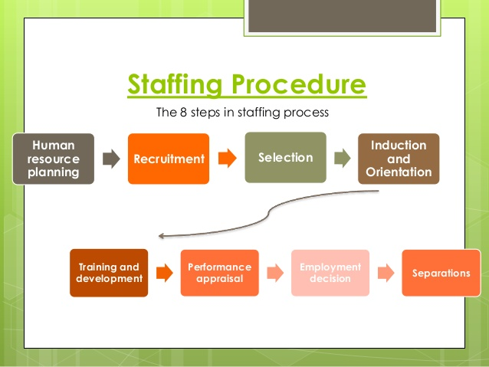
PROCESS OF STAFFING

Slide 6
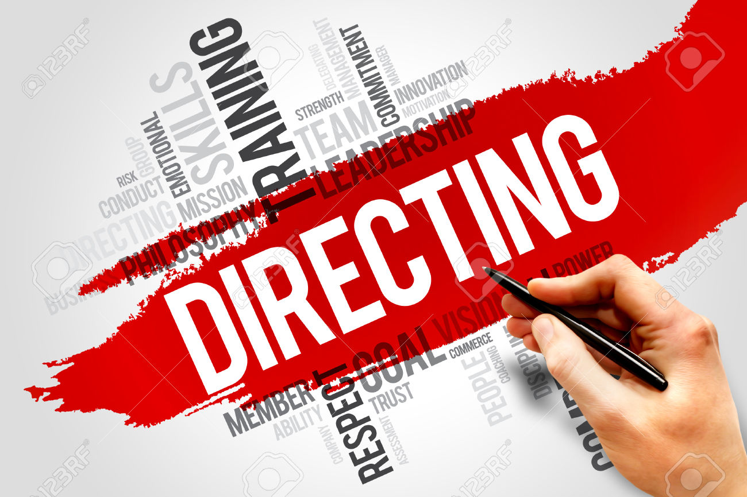


Slide 7
DIRECTING
Directing is the managerial function that consists of those activities which are concerned directly with influencing, guiding or supervising the subordinates in their jobs.
Directing is “a managerial function that involves the responsibility of managers for communicating to others what their roles are in achieving the company plan.”
Pearce and Robinson
“Direction is the sum total of managerial efforts that are applied for guiding and inspiring the working terms to make better accomplishments in the organisation. ”
S.S. Chatterjee

Slide 8
FEATURES OR CHARACTERISTICS OF DIRECTING
It is concerned with issuing of orders and instructions to the subordinates.
It is guiding and counselling the subordinates in their work with a view to improving their performance.
It is supervision of the work of subordinates to ensure that it conforms to plans.
Directing is pervasive because it is performed at all levels of management.
It is a continuous process because it deals with the continuous guidance to be provided by the superiors to their subordinates.
It always follows a top down approach.
It provides linkage between other managerial functions such as planning, organising and staffing.

Slide 9
IMPORTANCE OF DIRECTION
1. Initiates action
2. Creates a sound work environment
3. Develops managers
4. Behavioural satisfaction
5. Increase in productivity
6. Achieves coordination
7. Facilitates control
8. Facilitates change
9. Facilitates growth

Slide 10
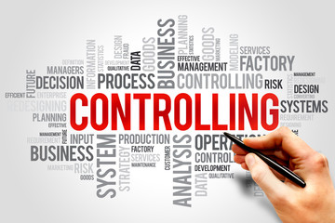

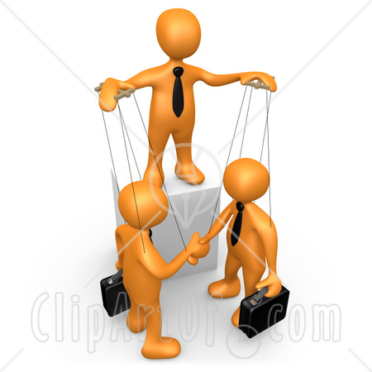

Slide 11
CONTROLLING
Definitions:
“Managerial control implies the measurement of accomplishment against the standard and the correction of deviations to assure attainment of objectives according to plans”.
Koontz And O’Donnell
“Control is the process of bringing about conformity of performance with planned action.”
Dale Henning
Controlling function is performed in all types of organizations whether commercial or non commercial and at all levels i.e. top, middle and supervisory levels of management. Thus, it is a pervasive function. Controlling should not be considered as the last function of the management.

Slide 12
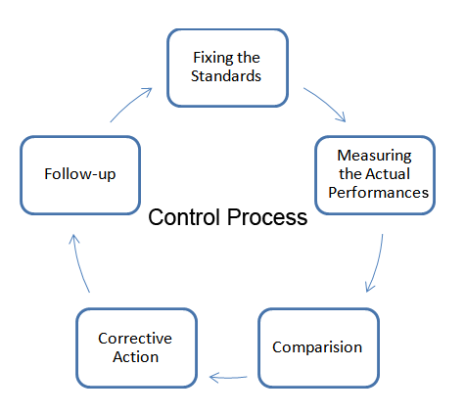
PROCESS OF CONTROLLING

Slide 13
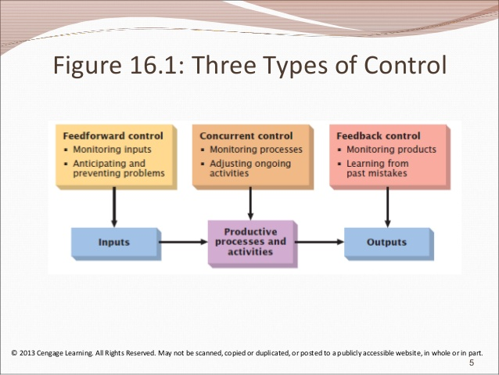

Slide 14
IMPORTANCE OF CONTROLLING
1. Accomplishing Organizational Goals
2. Judging Accuracy of Standards
4. Improving Employee Motivation
3. Making Efficient Use of Resources
5. Ensuring Order and Discipline
6. Facilitating Coordination in Action

Slide 15
Thank You….
Dr. Mitesh Hanwate

